Slide 1
Financial Aid
FAFSA Process 24-25

Slide 2

What Is Financial Aid?
Financial aid consists of funds provided to students and families to help pay for postsecondary educational expenses

Slide 3




What Is Cost of Attendance (COA)?
Tuition and fees
Housing and food
Books and supplies
Transportation
Miscellaneous and personal

Slide 4
What Is Student Aid Index (SAI)?
Number resulting from the evaluation of a student’s (and family’s) approximate financial resources for a student’s postsecondary education
Student contribution
Parent contribution
(for dependent students)

Slide 5
What Is Financial Need?
Cost of attendance (COA) – Student aid index (SAI) = Financial need

Slide 6
Categories of Financial Aid
Need-based aid
Non-need-based aid

Slide 7
Types of Financial Aid
Scholarships
Grants
Loans
Work-Study Employment
Self-Help Aid
Gift Aid

Slide 8
Sources of Financial Aid
Federal Government
Employers
States
Private Sources
College and Universities

Slide 9
Federal Government
Largest source of financial aid
Aid provided primarily based on financial need
Must apply each year using the FAFSA
Eligibility requirements must be met

Slide 10
Federal Student Aid Programs
Federal Pell Grant
Federal Supplemental Educational Opportunity Grant (FSEOG)
Teacher Education Assistance for College and Higher Education (TEACH) Grant
Federal Work-Study (FWS)
Federal Direct Student Loans (Direct Loans)
Federal PLUS Loans

Slide 11

Federal Student Aid Estimator
Early estimation regarding SAI and possible Title IV aid available
Requires demographic, income, and asset information
https://studentaid.gov/aid-estimator

Slide 12
Free Application for Federal Student Aid (FAFSA®)
www.studentaid.gov
  FAFSA® Application | Federal Student Aid
Collects demographic and financial information
Information used to calculate the student aid index (SAI)
Colleges use SAI to offer financial aid
Available in English and Spanish

Slide 13
Free Application for Federal Student Aid (FAFSA®)
May be filed at any time during an academic year, but typically no earlier than October 1st prior to the academic year for which the student requests aid
For the 2024-25 academic year, the FAFSA may be filed starting in late December 2023
Colleges may set FAFSA priority dates

Slide 14
Using Online FAFSA
Built-in edits to prevent costly errors
Skip-logic allows student and/or parent to skip unnecessary questions
No need to manually enter federal tax information (FTI)
Timely submission of original application and any necessary corrections
Detailed instructions and “help” for common questions
Ability to check application status online

Slide 15
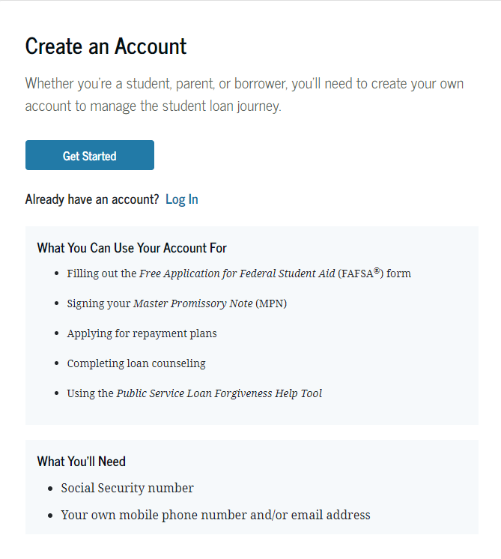
Account Username and Password (FSA ID)
Used for FAFSA completion
and access to certain U.S. Department of Education websites
Student and parent must
create their own FSA ID
May be used throughout
financial aid process,
including subsequent
school years
Only the owner should
create an FSA ID
Apply at https://studentaid.gov/fsa-id/create-account/launch

Slide 16

How To Create Account

Slide 17
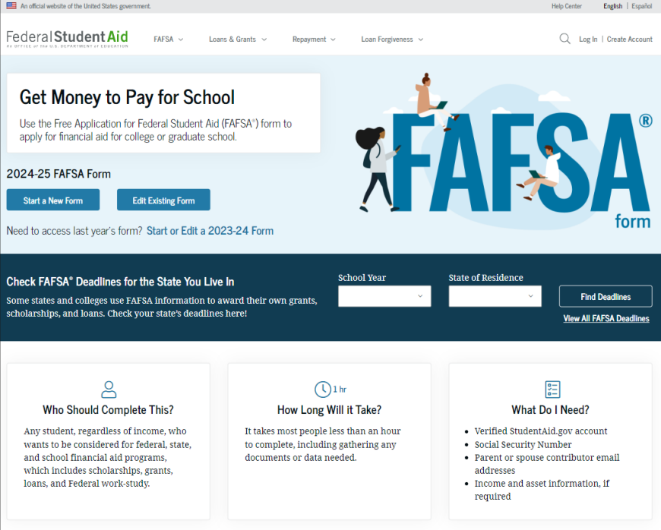
Online FAFSA
Note: Online FAFSA screenshots from U.S. Department of Education’s 2024-25 FAFSA Form Preview Presentation, July 2023

Slide 18
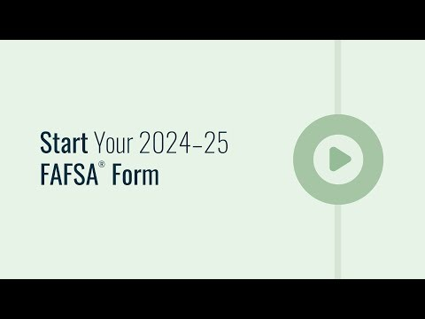
FAFSA 24-25

Slide 19
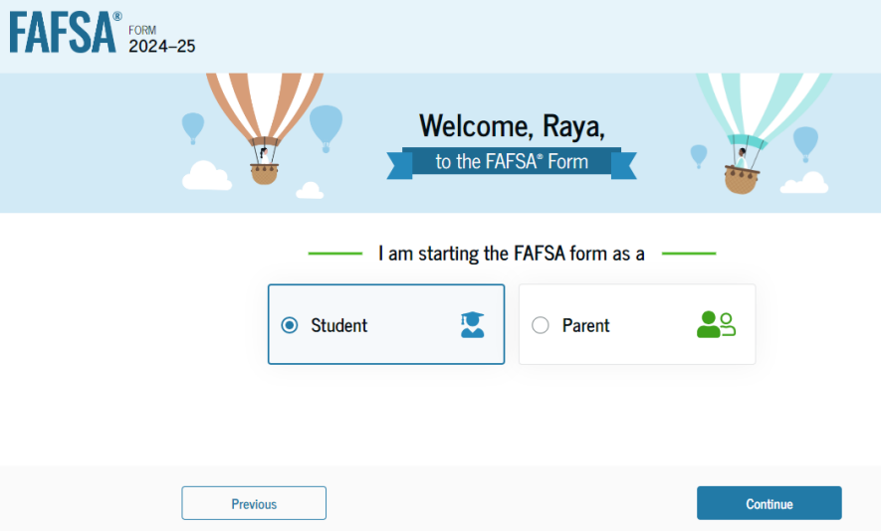
Online FAFSA

Slide 20
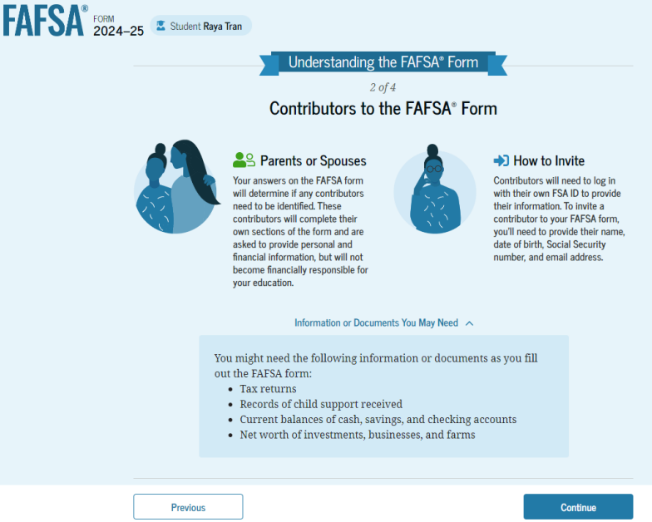
FAFSA Contributors

Slide 21
FUTURE Act Direct Data Exchange (FA-DDX)
Allows for an individual’s federal tax information (FTI) to be directly transferred from the IRS to the FAFSA
Consent is required by all contributors on FAFSA
IRS transfers information to populate FAFSA income questions for most tax filers
Eliminates manual entry of tax and income information

Slide 22
Student Information
Identity and contact information
Consent for FTI transfer from IRS
Marital status
College plans
Personal and unusual circumstances

Slide 23
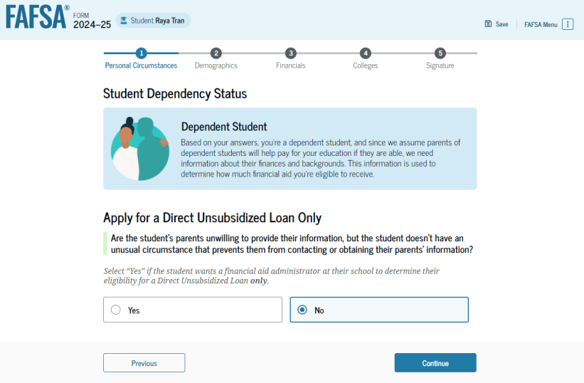
Student Dependency Status

Slide 24
Unusual Circumstances
Conditions that justify an institution making an adjustment to a student’s dependency status
Student does not provide parental data on FAFSA
    Considered provisionally independent
Student follows institution’s process for dependency override determination

Slide 25
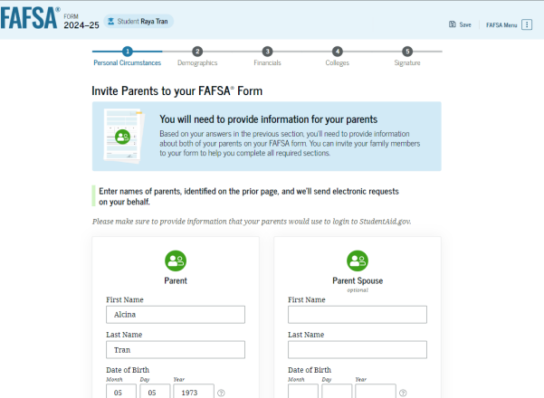
Student Invites Parents to FAFSA
Student provides personal information about parents to invite them to complete parent portion of the FAFSA

Slide 26
Student Information
Demographic information
Citizenship status
Parents’ education status
Parent killed in line of duty
High school information

Slide 27
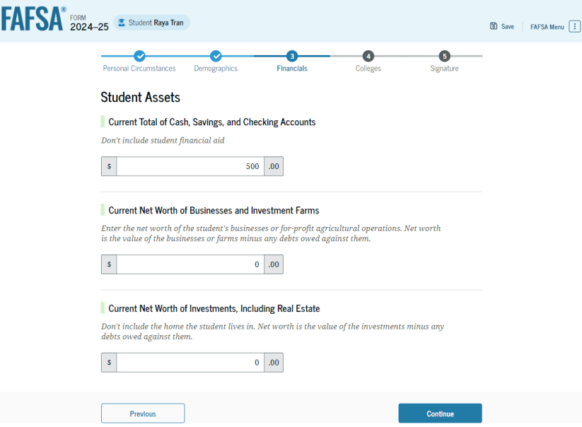
Student Financial Information
Tax return information
  Minimal questions if FTI transferred from IRS
Asset information

Slide 28
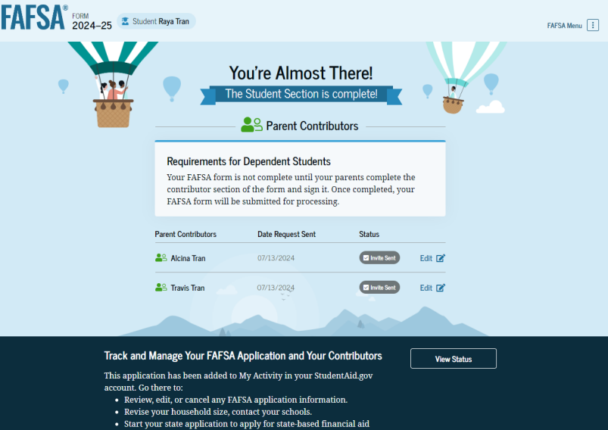
Student Section Completion
College selection
Review of information
Signature

Slide 29
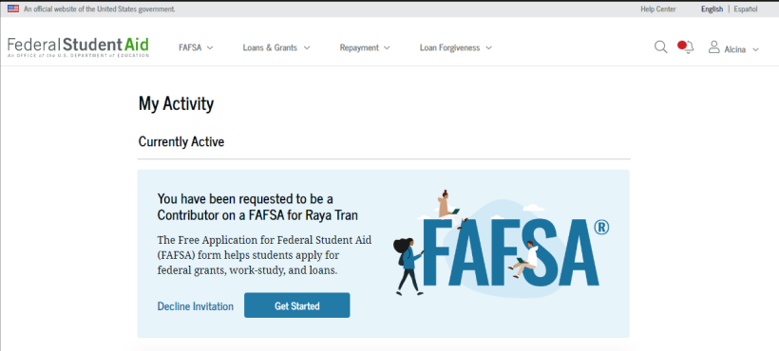
Parent Invitation
Email invitation to complete parent portion of student’s FAFSA
Parents must use FSA ID to access FAFSA

Slide 30
Parent Information
Identity and contact information
Consent for FTI transfer from IRS
Marital status
State of legal residence

Slide 31
Parent Financial Information
Tax filing status
Family size and number in college
Tax return information
  Minimal questions if FTI transferred from IRS
Assets
Other parent information

Slide 32
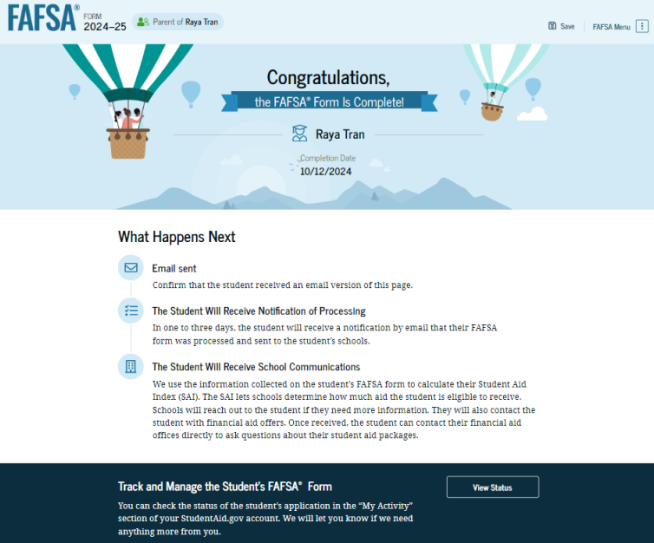
Parent Section Completion
Review of information
Signature and submission of FAFSA

Slide 33
Other Considerations
If independent student is married, spouse information is required as well
Consent to transfer FTI from the IRS is required for ALL contributors
  Including student, student’s spouse (if applicable), parent, and other parent (if applicable)
Students, parents, and preparers may start, complete, and submit a FAFSA

Slide 34
Who Is Included in Family Size?
Dependent Filers
Student
Independent Filers
Parent (and spouse)
Parent’s dependent children, even if they live apart from the parent because of college enrollment*
Other people if they live with the parent*
Student (and spouse)
Student’s dependent children, even if they live apart from the student because of college enrollment*
Other people if they live with the student*
* Included only if providing more than half of their support between July 1, 2024 and June 30, 2025

Slide 35



FAFSA Processing Results
FPS
College
Student

Slide 36
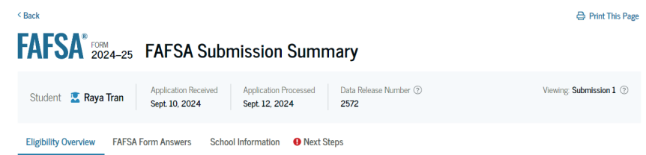
FAFSA Submission Summary
Four sections:
  Eligibility Overview
  FAFSA Form Answers
  School Information
  Next Steps
Ability to print summary

Slide 37
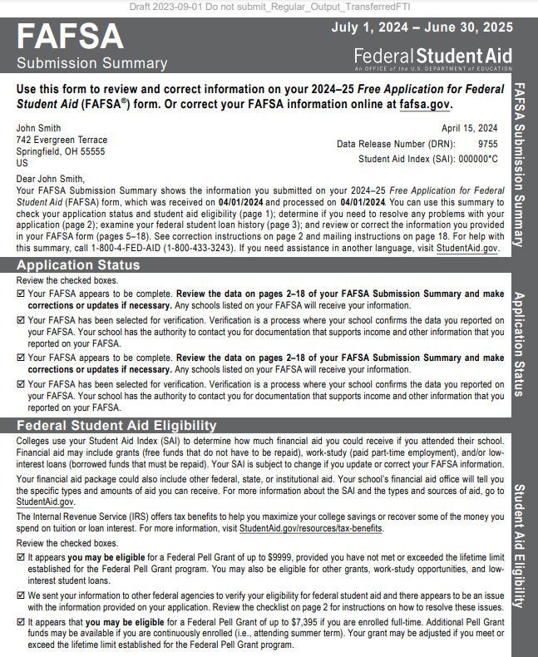
Paper FAFSA Submission Summary

Slide 38
Institutional Student Information Record (ISIR)
FPS sends results to colleges listed on the FAFSA
College reviews ISIR and may request additional documentation
This will be slower process in 24-25 due to all the changes

Slide 39
Making Corrections
If necessary, corrections to FAFSA data may be made by:
Using online FAFSA;
Updating paper FAFSA Submission Summary; or
Submitting documentation to college’s financial aid office.

Slide 40
Special Circumstances
Different than unusual circumstances (dependency overrides)
Unique conditions exist that cannot be documented with the FAFSA, or circumstances have changed since filing
Student should contact institution’s financial aid office for more information after filing FAFSA
Decisions are final and cannot be appealed to U.S. Department of Education

Slide 41

Special Circumstances
Unusual uncovered medical/dental expenses
Secondary school tuition
Extraordinary dependent care
Parent or spouse death
Additional family members in college
Loss of employment or income
Divorce

Slide 42
Thoughts
Be Patient – It is new – there are issues that are still being resolved; schools will be delayed getting info
Be Slow – make sure no errors before hitting enter
Be Accurate – Correct contributor(s)? Only counted required items as assets?
Do New York State TAP application afterwards
  www.hesc.ny.gov

